Slide 1
Data Preprocessing Lecture no 3

Slide 2
What is data wrangling
It is the process of converting raw data into a usable form. It may also be called:
Data preprocessing
Data preparation
Data munging
Data remediation

Slide 3
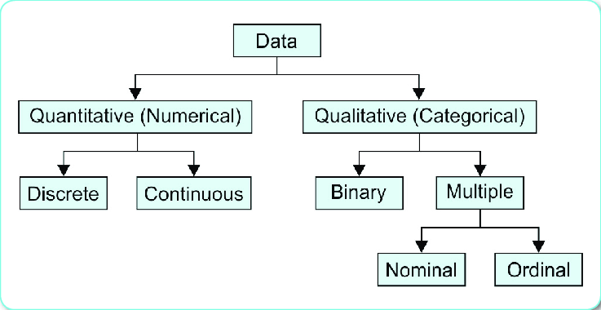
Types of data
Notes:
Discrete, students in class, shoe size (countable)
Continuous: weight height, temp (not countable)
Binary: yes/no, true/false
Nominal: gender, hair color, cities
Ordinal: rating, class level, ranking

Slide 4
Quality of data
Quality of data is measured on the basis of following factors:
Accuracy
Completeness
Consistency
Timeliness
Believability
Interpretability
Notes:
Issues: inconsistent formatting of dates and numbers, unusual character sets and symbols, duplicate entries, and different languages and measurement units
Accuracy: is the information correct
Completeness: data’s ability to effectively deliver all the required values
Consistency: uniformity of data. The same data values stored in difference locations should not conflict with one another.
Timeliness: How up-to-date is information
Believability: is it trustable?
Interpretability: how easy the data is understood.

Slide 5
Why Data Preprocessing?
Data in the real world is usually dirty
Incomplete
Noisy
Inconsistent
No quality data, no quality results!
Notes:
incomplete: missing attribute values, lack of certain attributes of interest, or containing only aggregate data e.g., occupation=“”
noisy: containing errors or outliers e.g., Salary=“-10”
inconsistent: containing discrepancies in codes or names e.g., Age=“42” Birthday=“03/07/1997” e.g., Was rating “1,2,3”, now rating “A, B, C” e.g., discrepancy between duplicate records
Quality decisions must be based on quality data e.g, duplicate or missing data may cause incorrect or even misleading statistics.

Slide 6
Tasks in Data Preprocessing
Data cleaning
Data integration
Data reduction
Data transformation
Data discretization (for numerical data)
Notes:
Data cleaning: Fill in missing values, smooth noisy data, identify or remove outliers and noisy data, and resolve inconsistencies
Data integration: Integration of multiple databases, or files
Data reduction: Obtains reduced representation in volume but produces the same or similar analytical results, dimensionality reduction and numerosity reduction. It replaces the original data volume by alternative, smaller forms of data representation e.g., Regression, Histograms, Clustering, Sampling
Data transformation: Normalization and aggregation
Discretization: raw data values for attributes are replaced by ranges or higher conceptual levels. e.g. raw values for age may be replaced by higher-level concepts, such as youth, adult, or senior.

Slide 7
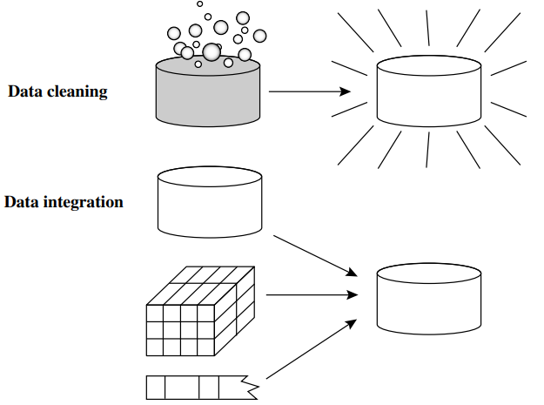
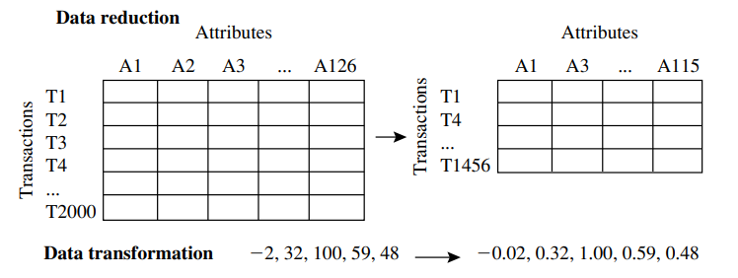

Slide 8
Data Cleaning

Slide 9
Data cleaning
Fill in missing values
Identify outliers and smooth out noisy data
Correct inconsistent data

Slide 10
Missing Values
Data is not always available
Missing data may be due to
Equipment malfunction
Inconsistent with other recorded data and thus deleted
Data not entered due to misunderstanding
Certain data may not be considered important at the time of entry
Not register history or changes of the data
Notes:
E.g., many tuples have no recorded values for several attributes, such as customer income in sales data

Slide 11
How to handle missing data?
Ignore the tuple
Fill in the missing value manually
Use a global constant to fill in the missing value
Use a measure of central tendency for the attribute (e.g., the mean or median)
Use the attribute mean or median for all samples belonging to the same class.
Use the most probable value, inference-based such as regression, Bayesian formula, decision tree
Notes:
1- not very effective, unless the tuple contains several attributes with missing values.
2- time consuming and may not be feasible given a large data set
3- If missing values are replaced by, say, “Unknown,” then the mining program may mistakenly think that they form an interesting concept
4- For normal (symmetric) data distributions, the mean can be used, while skewed data distribution should employ the median & mode for categorical data
5- if classifying customers according to credit risk, we may replace the missing value with the mean income value for customers in the same credit risk category as that of the given tuple.
6- predict the missing value (popular strategy)
Note: a missing value may not imply an error in the data!. Ideally, each attribute should have one or more rules regarding the null condition.

Slide 12
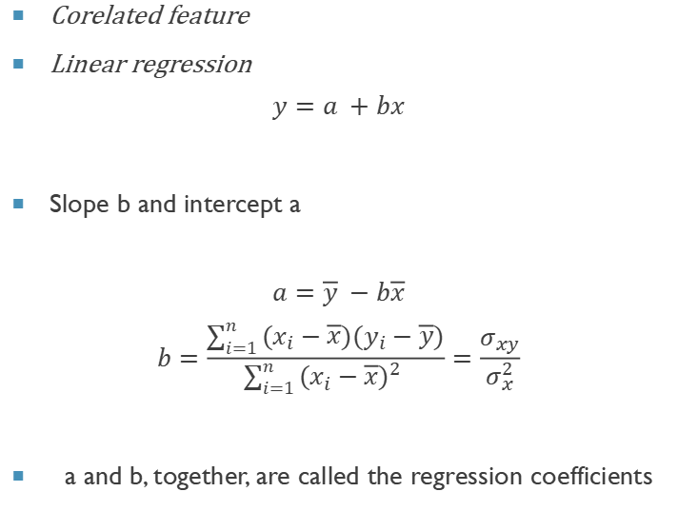
Regression Imputation
Corelated feature
Linear regression
$$y=a +bx$$
Slope b and intercept a
$$a=\overline{y} −b\overline{x}$$
$$b=\frac{\sum_{i=1}^{n}{(x_{i}−\overline{x})(y_{i}−\overline{y})}}{\sum_{i=1}^{n}{{(x_{i}−\overline{x})}^{2} }}=\frac{σ_{xy}}{σ_{x}^{2}}$$
a and b, together, are called the regression coefficients
Notes:
What is the difference between interpolation and imputation? While imputation replaces missing data for the column's mean, interpolation is a sort of estimation that creates data points within the range of a discrete set of existing data points

Slide 13
Noisy data
Random error in a measured variable is noise.
Incorrect attribute values due to
Faulty data collection instruments
Data entry problems
Data transmission problems
Other data problems which requires data cleaning
duplicate records, incomplete data, inconsistent data

Slide 14
Outliers
Data points inconsistent with the majority of data
Different outliers
Valid: CEO’s salary,
Noisy: One’s age = 200, widely deviated points
Removal methods
Clustering
Curve-fitting
Hypothesis-testing with a given model

Slide 15
identifying outliers: Z-score
z-score method for identifying outliers, states that a data value is an outlier if it has a Z- score that is either less than or greater than 3.
Example: Suppose we have the following values for salary (in thousands of dollars),
10,7,20,12,75,15,9,18,4,12,8,14
Notes:
Unfortunately, the mean and SD, which are both part of the formula for the Z-score standardization, are both rather sensitive to the presence of outliers.

Slide 16
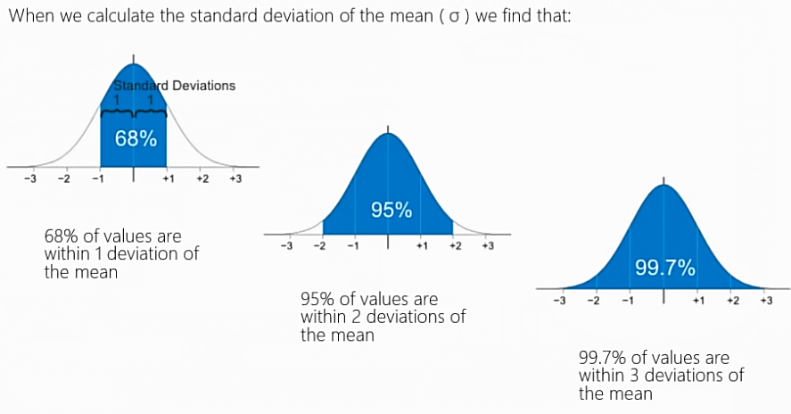
Standard Normal Distribution

Slide 17
identifying outliers: IQR(Inter Quartile range)
Robust statistical methods for outlier detection
Less sensitive to the presence of the outliers themselves
The quartiles of a data set divide the data set into the following four parts, each containing 25% of the data:
The first quartile (Q1) is the 25th percentile
The second quartile (Q2) is the 50th percentile, that is, the median.
The third quartile (Q3) is the 75th percentile
Five-number summary of a data set consists of the minimum, Q1,median,Q3, and the maximum.
The IQR is a measure of variability, much more robust than the SD
IQR = Q3 − Q1
IQR may be interpreted to represent the spread of the middle 50% of the data
A data value is an outlier if
a. it is located 1.5(IQR) below the first quartile Q1, or
b. it is located 1.5(IQR) above the third quartile Q3.
Notes:
The quartiles give an indication of a distribution’s center, spread, and shape.

Slide 18
IQR(Inter Quartile range) Method
Step 1: Sort the data
Step 2: Find min,,max, median
Step 3: Find Q1,Q3
Step 4: Find IQR
Step 5: Identify outlier using IQR
Find outlier
10,7,20,12,75,15,9,18,4,8,14

Slide 19
How to handle noisy data
Binning method:
first sort data and partition into bins
Clustering
detect and remove outliers
Regression
smooth by fitting the data into regression functions

Slide 20
Binning
Binning methods smooth a sorted data value by consulting its “neighborhood,” that is, the values around it
Sorted values are distributed into a number of “buckets,” or bins
equi-depth/equi-width bins
Notes:
first sort data and partition into (equi-depth/equi-width) bins
then one can smooth by bin means, smooth by bin median, smooth by bin boundaries, etc.
used also for discretization (discussed later)

Slide 21
Binning Methods:
Equal-width (distance) partitioning:
It divides the range into N intervals of equal size: uniform grid
if A and B are the lowest and highest values of the attribute, the width of intervals will be: W = (B-A)/N.
Equal-depth (frequency) partitioning:
It divides the range into N intervals, each containing approximately same number of samples

Slide 22
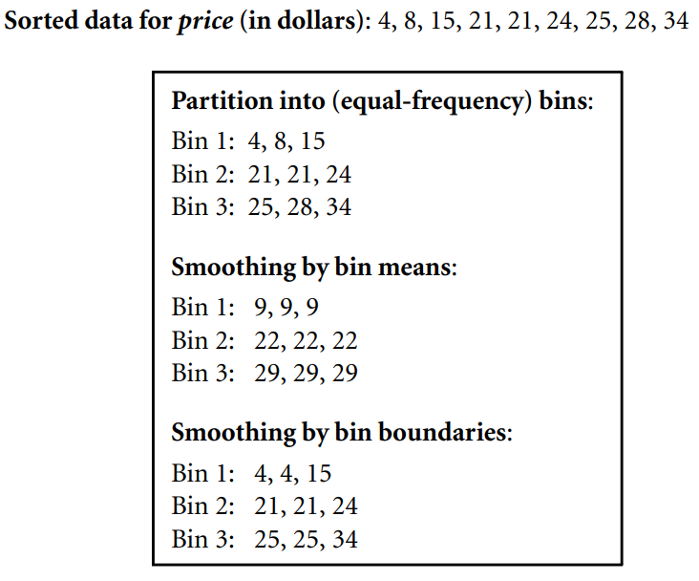
Binning methods for data smoothing

Slide 23
Binning Methods for Data Smoothing
* Sorted data : 4, 8, 9, 15, 21, 21, 24, 25, 26, 28, 29, 34
* N=3
* Partition into (equi-width) bins

Slide 24
Regression
y
Y1
Y1’
y = x + 1
X1
x
Linear regression (best line to fit two variables)
Multiple linear regression (more than two variables, fit to a multidimensional surface)

Slide 25
Clustering

Slide 26
Data Integration

Slide 27
Data integration
Merging of data from multiple sources
Schema integration
integrate metadata from different sources
Detecting and resolving data value conflicts
Notes:
Schema integration: Entity identification problem: identify real world entities from multiple data sources, e.g., A.cust-id ≡ B.cust-#
Value conflict: for the same real world entity, attribute values from different sources are different, e.g., different scales, metric vs. British units

Slide 28
Entity identification problem
How can equivalent real-world entities from multiple data sources be matched up?
Schema Integration
Object matching
Notes:
schema integration is about putting together data in a way that makes sense, and
object matching is like finding and connecting equivalent things from different sources.

Slide 29
How to handle identification problem
Using meta-data associated with attributes (name, meaning, data type, and value range)
It also supports data transformation, especially with varying data codes.
Consider Data Structure when matching attributes
functional dependencies and referential constraints must align between sources.
Notes:
Dependencies: an example, such as the proper application of discounts in different systems.

Slide 30
Redundancy
Data redundancy occurs when the same piece of data is stored in two or more separate places
An attribute may be redundant if it can be “derived” from another attribute
Inconsistencies in attribute or dimension naming can also cause redundancies
Some redundancies can be detected by correlation analysis.
Notes:
An attribute (such as annual revenue, for instance) may be redundant if it can be “derived” from another attribute or set of attributes

Slide 31
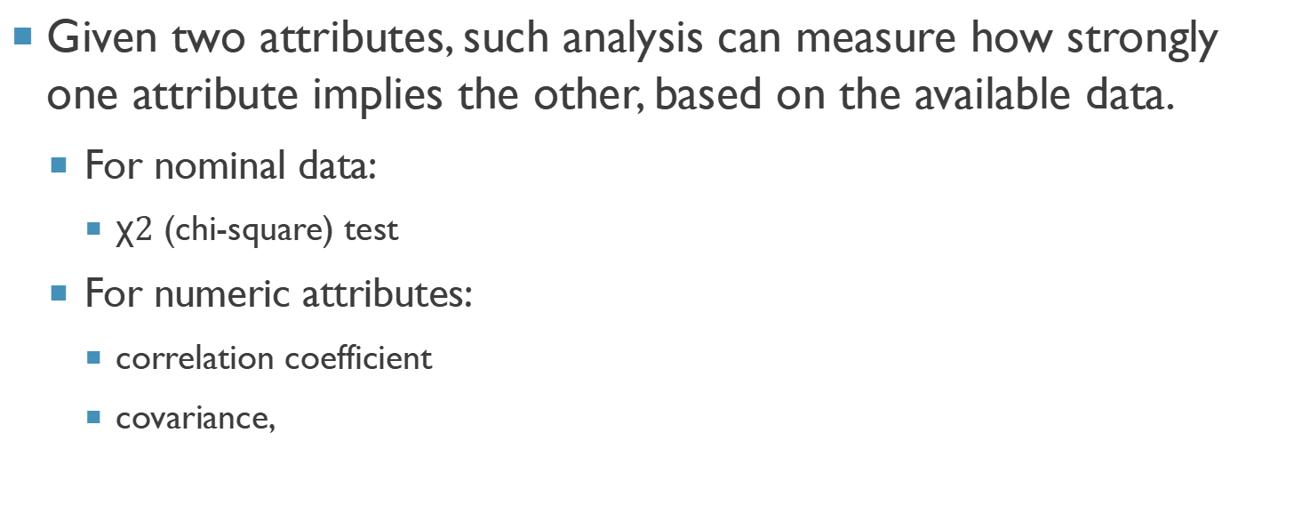
Correlation analysis
Given two attributes, such analysis can measure how strongly one attribute implies the other, based on the available data.
For nominal data:
χ$2$ (chi-square) test
For numeric attributes:
correlation coefficient
covariance,

Slide 32


$X^{2}$ Correlation Test
Create a contingency table for any two attributes.
State hypothesis
Alpha value is selected (significance value)
Calculate expected values
If calculated value chi-square is less than or equal to the critical/tabular value, then the attributes are not correlated.
Notes:
Significance value = less the value more the precision

Slide 33
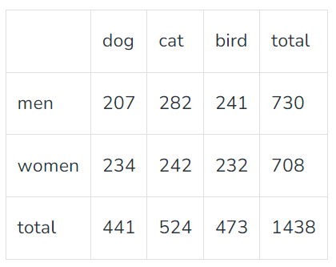

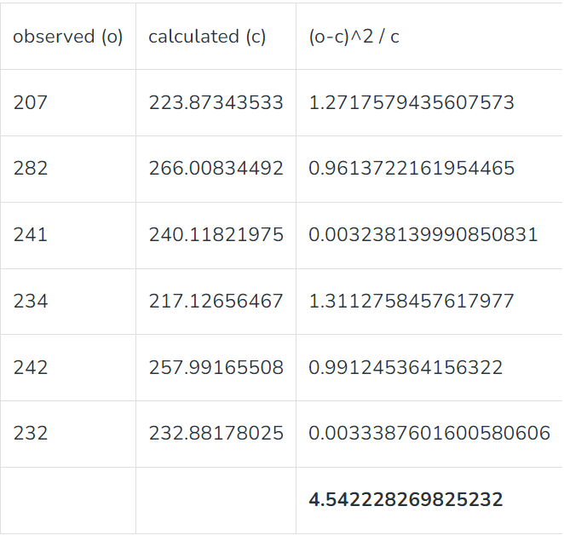

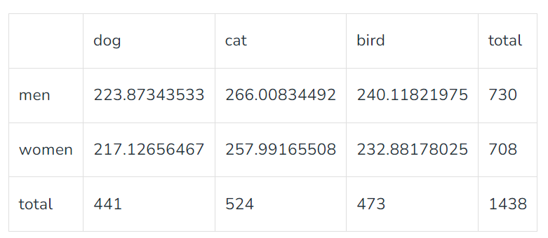

Slide 34

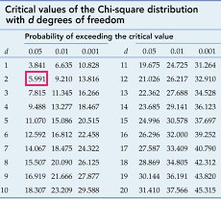
Example cont.
The degrees of freedom is defined as : (no. of rows – 1) * (no. of columns – 1) = (2-1) * (3-1) = 2
5.991 > 4.54
So we can infer that no correlation exist.
Library: scipy
Function: chi2_contingency

Slide 35



Covariance
For assessing how much two attributes change together.
Calculate expected value for each attribute
Compute covariance
covariance of 0 imply independence
Notes:
Change in scale: correlation no effect, covariance effected
Correlation -1 to +1, covariance –inf to +inf

Slide 36
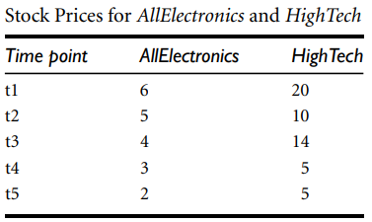



example
The positive covariance we can say that stock prices for both companies rise together.

Slide 37
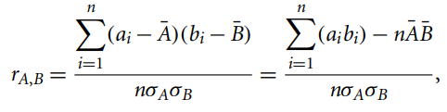

Correlation coefficient
If r is greater than 0, then A and B are positively correlated, may indicate redundancy.
If the resulting value is equal to 0, then A and B are independent.
If the resulting value is less than 0, then A and B are negatively correlated.

Slide 38
Data reduction

Slide 39
Data reduction
Data reduction techniques can be applied to obtain a reduced representation of the data set.
Dimensionality reduction
Numerosity reduction
Data compression

Slide 40
dimensionality reduction
It is the process of reducing the number of attributes under consideration.
Wavelet Transforms
Principal Components Analysis
Attribute Subset Selection

Slide 41
Principal component analysis
Given N data vectors from n-dimensions, find k≤ n orthogonal vectors (principal components) that can be best used to represent data
Normalize input data
Compute k orthonormal (unit) vectors, i.e., principal components
The principal components are sorted in order of decreasing “significance” or strength
Since the components are sorted, the size of the data can be reduced by eliminating the weak components
Works for numeric data only
Notes:
i.e., those with low variance (i.e., using the strongest principal components, it is possible to reconstruct a good approximation of the original data)

Slide 42
Attribute subset selection
Reduces the data set size by removing irrelevant or redundant attributes (or dimensions).
Attribute selection methods:
Best step-wise feature selection: The best single-attribute is picked first
Step-wise attribute elimination: Repeatedly eliminate the worst attribute
Best combined attribute selection and elimination
Decision Tree Induction
Notes:
For n attributes, there are 2 n possible subsets
Attribute construction: h,w to area

Slide 43
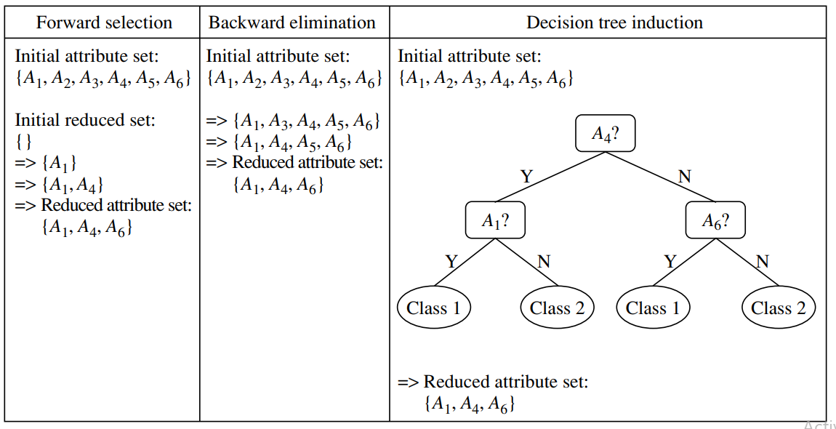

Slide 44
Numerosity reduction
It replaces the original data volume by alternative, smaller forms of data representation.
Regression
Histograms
Clustering
Sampling

Slide 45
Numerosity reduction
Parametric methods(e.g., regression)
Assume the data fits some model, estimate model parameters, store only the parameters, and discard the data (except possible outliers)
Ex.: Log-linear models—obtain value at a point in m-D space as the product on appropriate marginal subspaces
Non-parametric methods
Do not assume models
Major families: histograms, clustering, sampling, …

Slide 46
Histograms
Histograms use binning to approximate data distributions and are a popular form of data reduction.
Equal width bins
Equal frequency bins

Slide 47
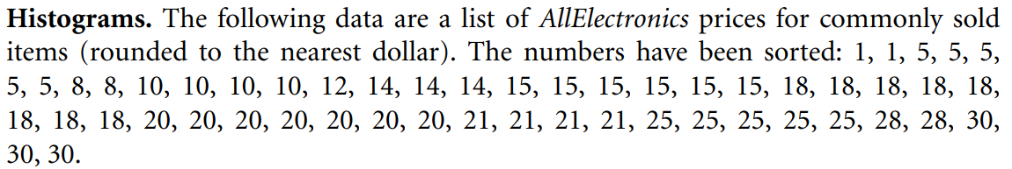
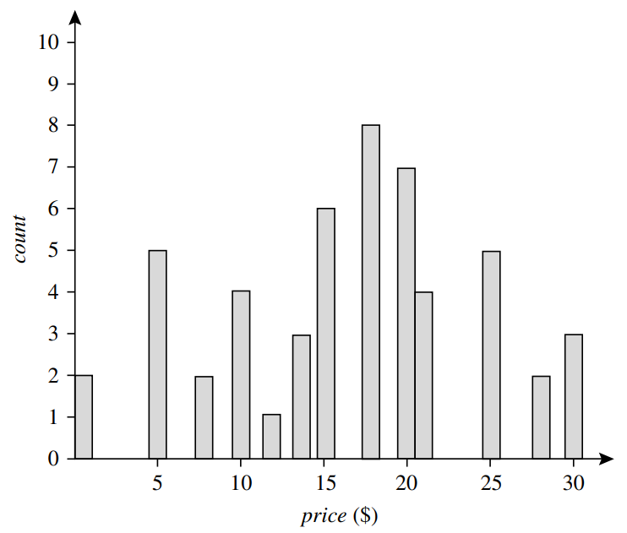
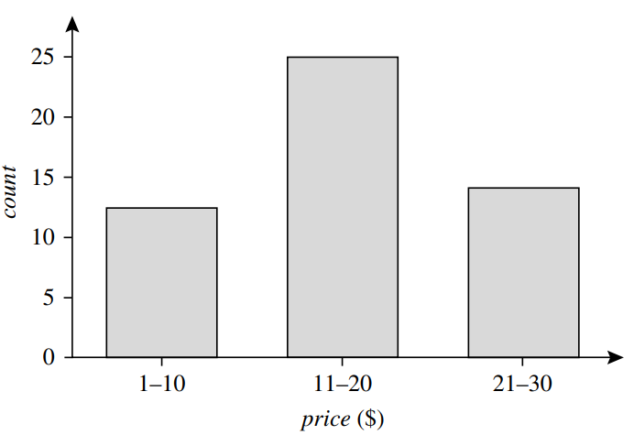

Slide 48
Data compression
In data compression, transformations are applied so as to obtain a reduced or “compressed” representation of the original data.
Lossless
Lossy

Slide 49
Data compression
String compression
There are extensive theories and well-tuned algorithms
Typically lossless, but only limited manipulation is possible without expansion
Audio/video compression
Typically lossy compression, with progressive refinement
Sometimes small fragments of signal can be reconstructed without reconstructing the whole

Slide 50
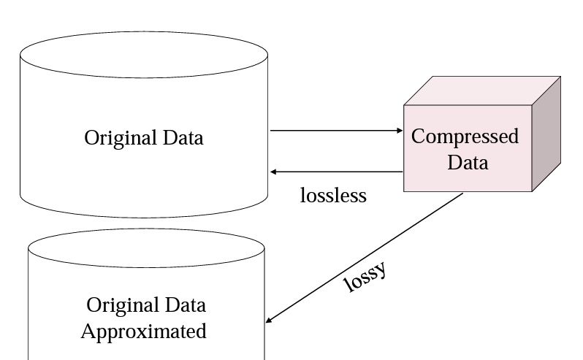
Data compression

Slide 51
Data transformation

Slide 52
Data transformation
In data transformation, the data are transformed or consolidated into forms appropriate may be more efficient, and the patterns found may be easier to understand.
Smoothing
Attribute construction
Aggregation
Normalization
Discretization
Concept hierarchy generation for nominal data
Notes:
Smoothing, which works to remove noise from the data. Techniques include binning, regression, and clustering.
Attribute construction (or feature construction), where new attributes are constructed and added from the given set of attributes
3. Aggregation, where summary or aggregation operations are applied to the data. For example, the daily sales data may be aggregated so as to compute monthly and annual total amounts.
4. Normalization, where the attribute data are scaled so as to fall within a smaller range, such as −1.0 to 1.0, or 0.0 to 1.0.
Discretization, where the raw values of a numeric attribute (e.g., age) are replaced by interval labels (e.g., 0–10, 11–20, etc.) or conceptual labels (e.g., youth, adult, senior). The labels, in turn, can be recursively organized into higher-level concepts, resulting in a concept hierarchy for the numeric attribute. More than one concept hierarchy can be defined for the same attribute to accommodate the needs of various users.
6. Concept hierarchy generation for nominal data, where attributes such as street can be generalized to higher-level concepts, like city or country.

Slide 53
Normalization techniques:
min-max normalization
z-score normalization
normalization by decimal scaling
Where j is the smallest integer such that Max (| |) < 1

Slide 54
min-max normalization
Suppose that the minimum and maximum values for the attribute income are $12,000 and $98,000, respectively.
We would like to map income to the range [0,1]
By min-max normalization, a value of $73,600 for income is transformed to
(73,600−12,000)/(98,000−12,000)* (1− 0) + 0 = 0.716.
Notes:
This approach is not effective when the maximum and minimum values are extreme value
outliers because of some mistake in data collection
Min-max normalization preserves the relationships among the original data values

Slide 55
Example

Slide 56
z-score normalization
Example: Suppose that the mean and standard deviation of the values for the attribute income are $54,000 and $16,000, respectively.
With z-score normalization, a value of $73,600 for income is transformed to 73,600−54,000 /16,000 = 1.225.
A variation of this z-score normalization replaces the standard deviation by the mean absolute deviation of A
The mean absolute deviation of A, denoted s_{A}, is
Notes:
The mean absolute deviation, sA, is more robust to outliers than the standard deviation,
σA. When computing the mean absolute deviation, the deviations from the mean (i.e.,
|xi − ¯x|) are not squared; hence, the effect of outliers is somewhat reduced
A negative z-score indicates that the data point is below the mean.
A positive z-score indicates that the data point is above the mean.

Slide 57
Decimal Scaling
Suppose that the recorded values of A range from −986 to 917.
The maximum absolute value of A is 986.
To normalize by decimal scaling, we therefore divide each value by 1000 (i.e., j = 3) so that −986 normalizes to −0.986 and 917 normalizes to 0.917.

Slide 58
Normalization
Normalization can change the original data quite a bit, especially when using z-score normalization or decimal scaling
It is also necessary to save the normalization parameters (e.g., the mean and standard deviation if using z-score normalization) so that future data can be normalized in a uniform manner.

Slide 59
discretization
It is often necessary to transform a continuous attribute into a categorical attribute (discretization), and both continuous and discrete attributes may need to be transformed into one or more binary attributes (binarization)
Notes:
If a categorical attribute has a large number of values (categories), or some values occur infrequently, then it may be beneficial for certain data mining tasks to reduce the number of categories by combining some of the values.

Slide 60
Why Discretization is Used?
Reduce data size
Transforming quantitative data to qualitative data
Discretization can be performed recursively on an attribute

Slide 61
Discretization by Binning
Binning is a top-down splitting technique based on a specified number of bins
Attribute values can be discretized by applying equal-width or equal-frequency binning, and then replacing each bin value by the bin mean or median, as in smoothing by bin means or smoothing by bin medians, respectively.
These techniques can be applied recursively to the resulting partitions to generate concept hierarchies.
Binning does not use class information and is therefore an unsupervised discretization technique
It is sensitive to the user-specified number of bins, as well as the presence of outliers.

Slide 62
Discretization by Binning: Example

Slide 63
Discretization by Binning: Example
Iris Dataset

Slide 64
Discretization by Histogram Analysis
Like binning, histogram analysis is an unsupervised discretization technique because it does not use class information.
A histogram partitions the values of an attribute, A, into disjoint ranges called buckets or bins
Various partitioning rules can be used to define histograms
In an equal-width histogram, for example, the values are partitioned into equal-size partitions or ranges
With an equal-frequency histogram, the values are partitioned so that, ideally, each partition contains the same number of data tuples
The histogram analysis algorithm can be applied recursively to each partition in order to automatically generate a multilevel concept hierarchy, with the procedure terminating once a prespecified number of concept levels has been reached.
This specifies the minimum width of a partition, or the minimum number of values for each partition at each level.

Slide 65
Discretization methods:
Binning (data smoothing)
Histogram analysis
Clustering analysis
Entropy-based discretization

Slide 66
Binarization
In some cases, it is desirable to use numeric data mining algorithms on categorical data
Because binary data is a special form of both numeric and categorical data, it is possible to convert the categorical attributes to binary form and then use numeric algorithms on the binarized data
If a categorical attribute has m different values, then m different binary attributes are created
Each binary attribute corresponds to one possible value of the categorical attribute
Therefore, exactly one of the m attributes takes on the value of 1, and the remaining take on the value of 0

Slide 67
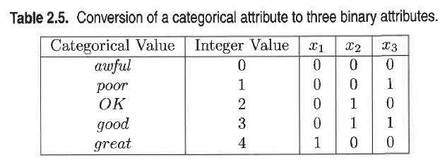
Binarization

Slide 68
Binarization
A binary attribute is a nominal attribute with only two categories or states: 0 or 1, where 0 typically means that the attribute is absent, and 1 means that it is present.
Binary attributes are referred to as Boolean if the two states correspond to true and false
A binary attribute is symmetric if both of its states are equally valuable and carry the same weight; that is, there is no preference on which outcome should be coded as 0 or 1.
One such example could be the attribute gender having the states male and female.
A binary attribute is asymmetric if the outcomes of the states are not equally important, such as the positive and negative outcomes of a medical test for HIV
By convention, we code the most important outcome, which is usually the rarest one, by 1 (e.g., HIV positive) and the other by 0 (e.g., HIV negative).

Slide 69
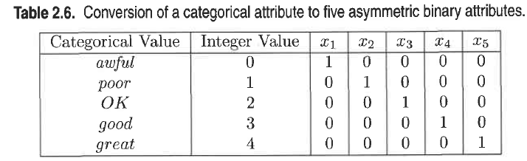
Binarization

